Slide 1

Chapter 8 - Memory

Slide 2
Agenda
How Memory Functions
Parts of the Brain Involved in Memory
Problems with Memory
Ways to Enhance Memory

Slide 3
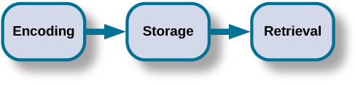
How Memory Works

Slide 4
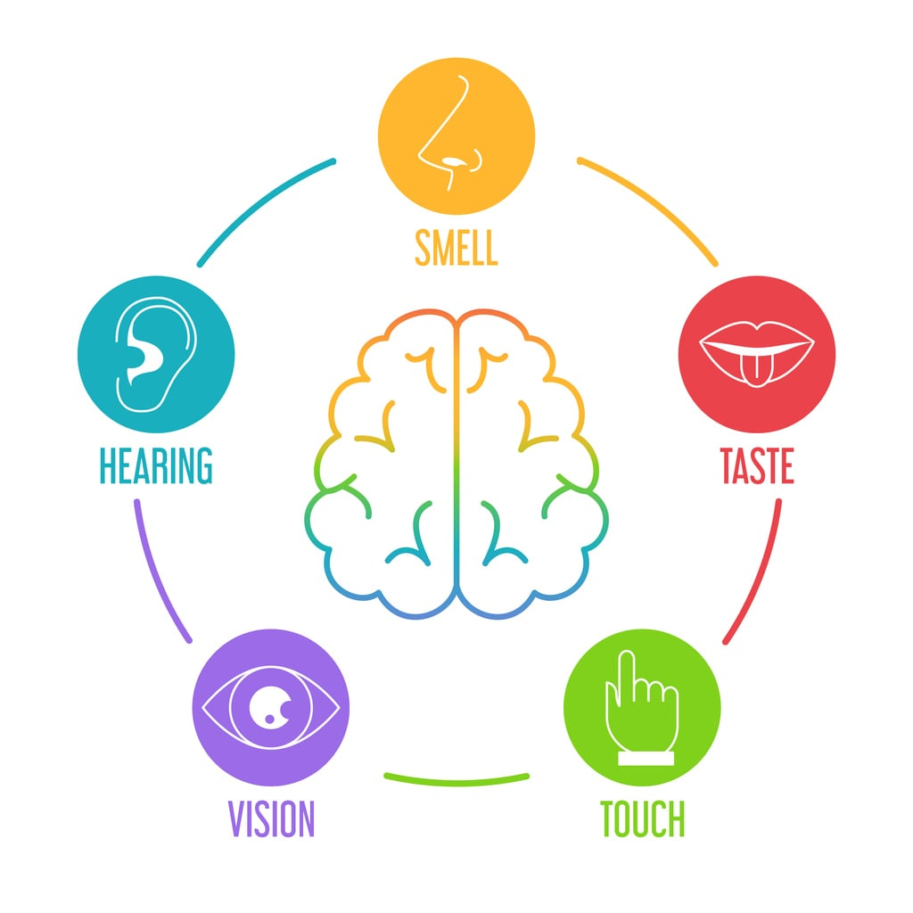
Step 1: Encoding

Slide 5
Types of Encoding
Semantic
Visual
Acoustic

Slide 6
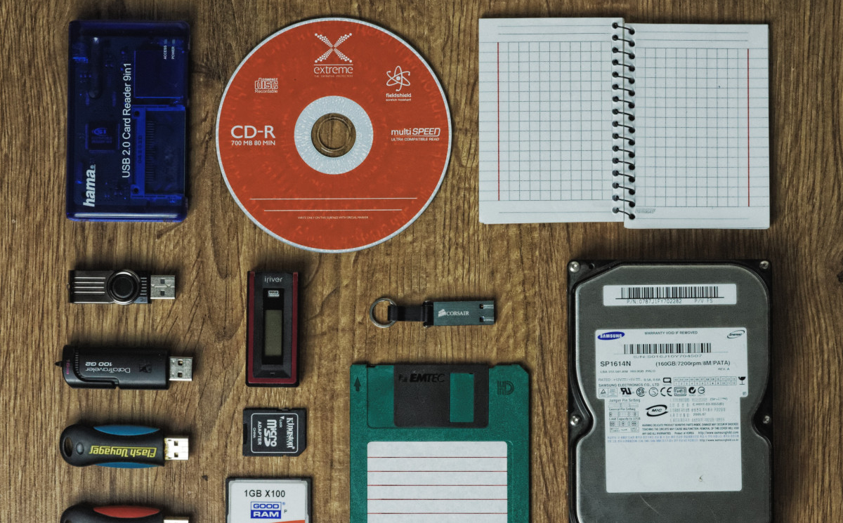
Step 2: Storing Memories

Slide 7
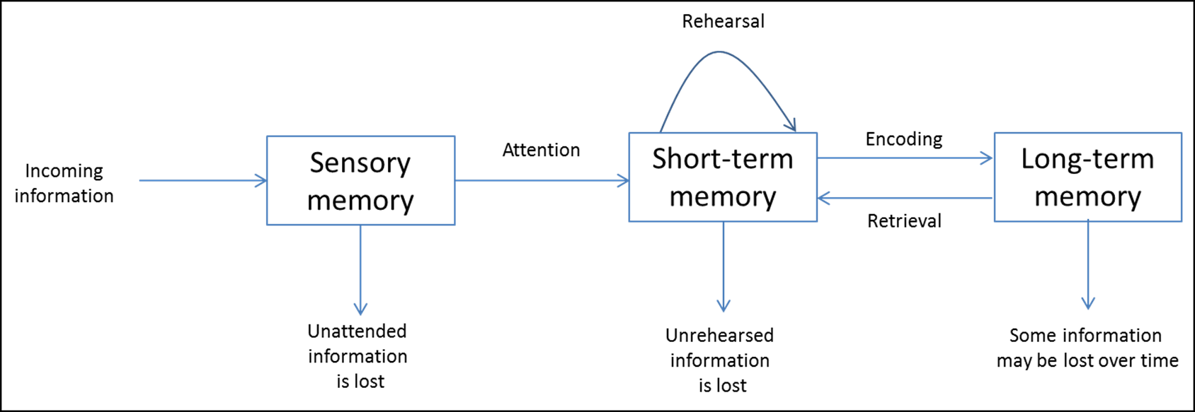
Atkinson-Shiffrin Model of Memory

Slide 8
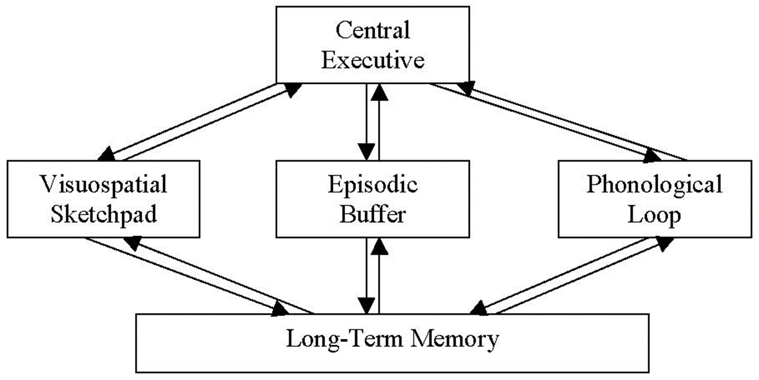
Baddeley’s 2000 Model of Working Memory

Slide 9
How long does something stay in your short-term memory?
How many items can you keep in your short-term memory?
What is the difference between active rehearsal and elaborative rehearsal?

Slide 10
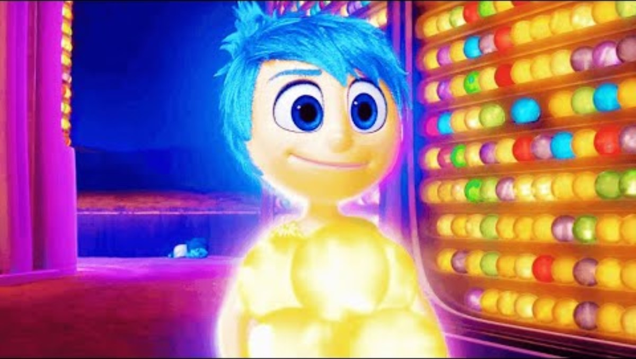
Visualizing Long-Term Memory

Slide 11
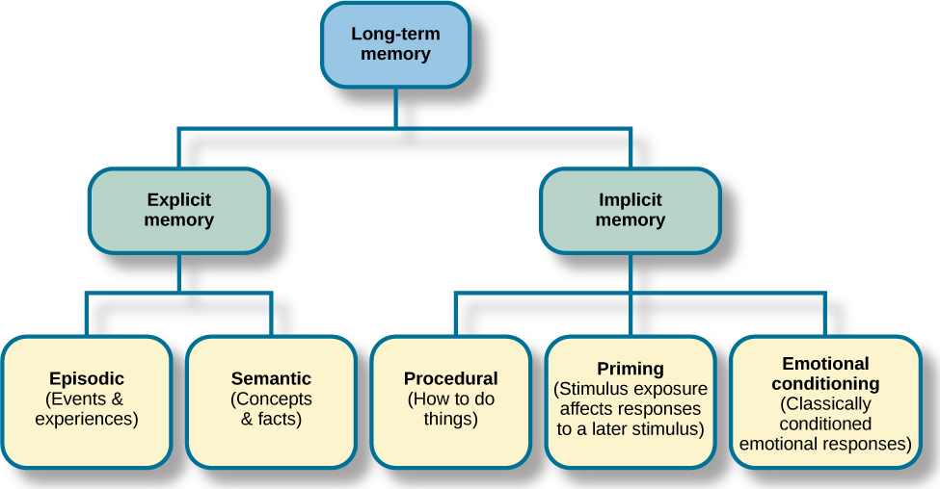
Types of Long-Term Memory

Slide 12
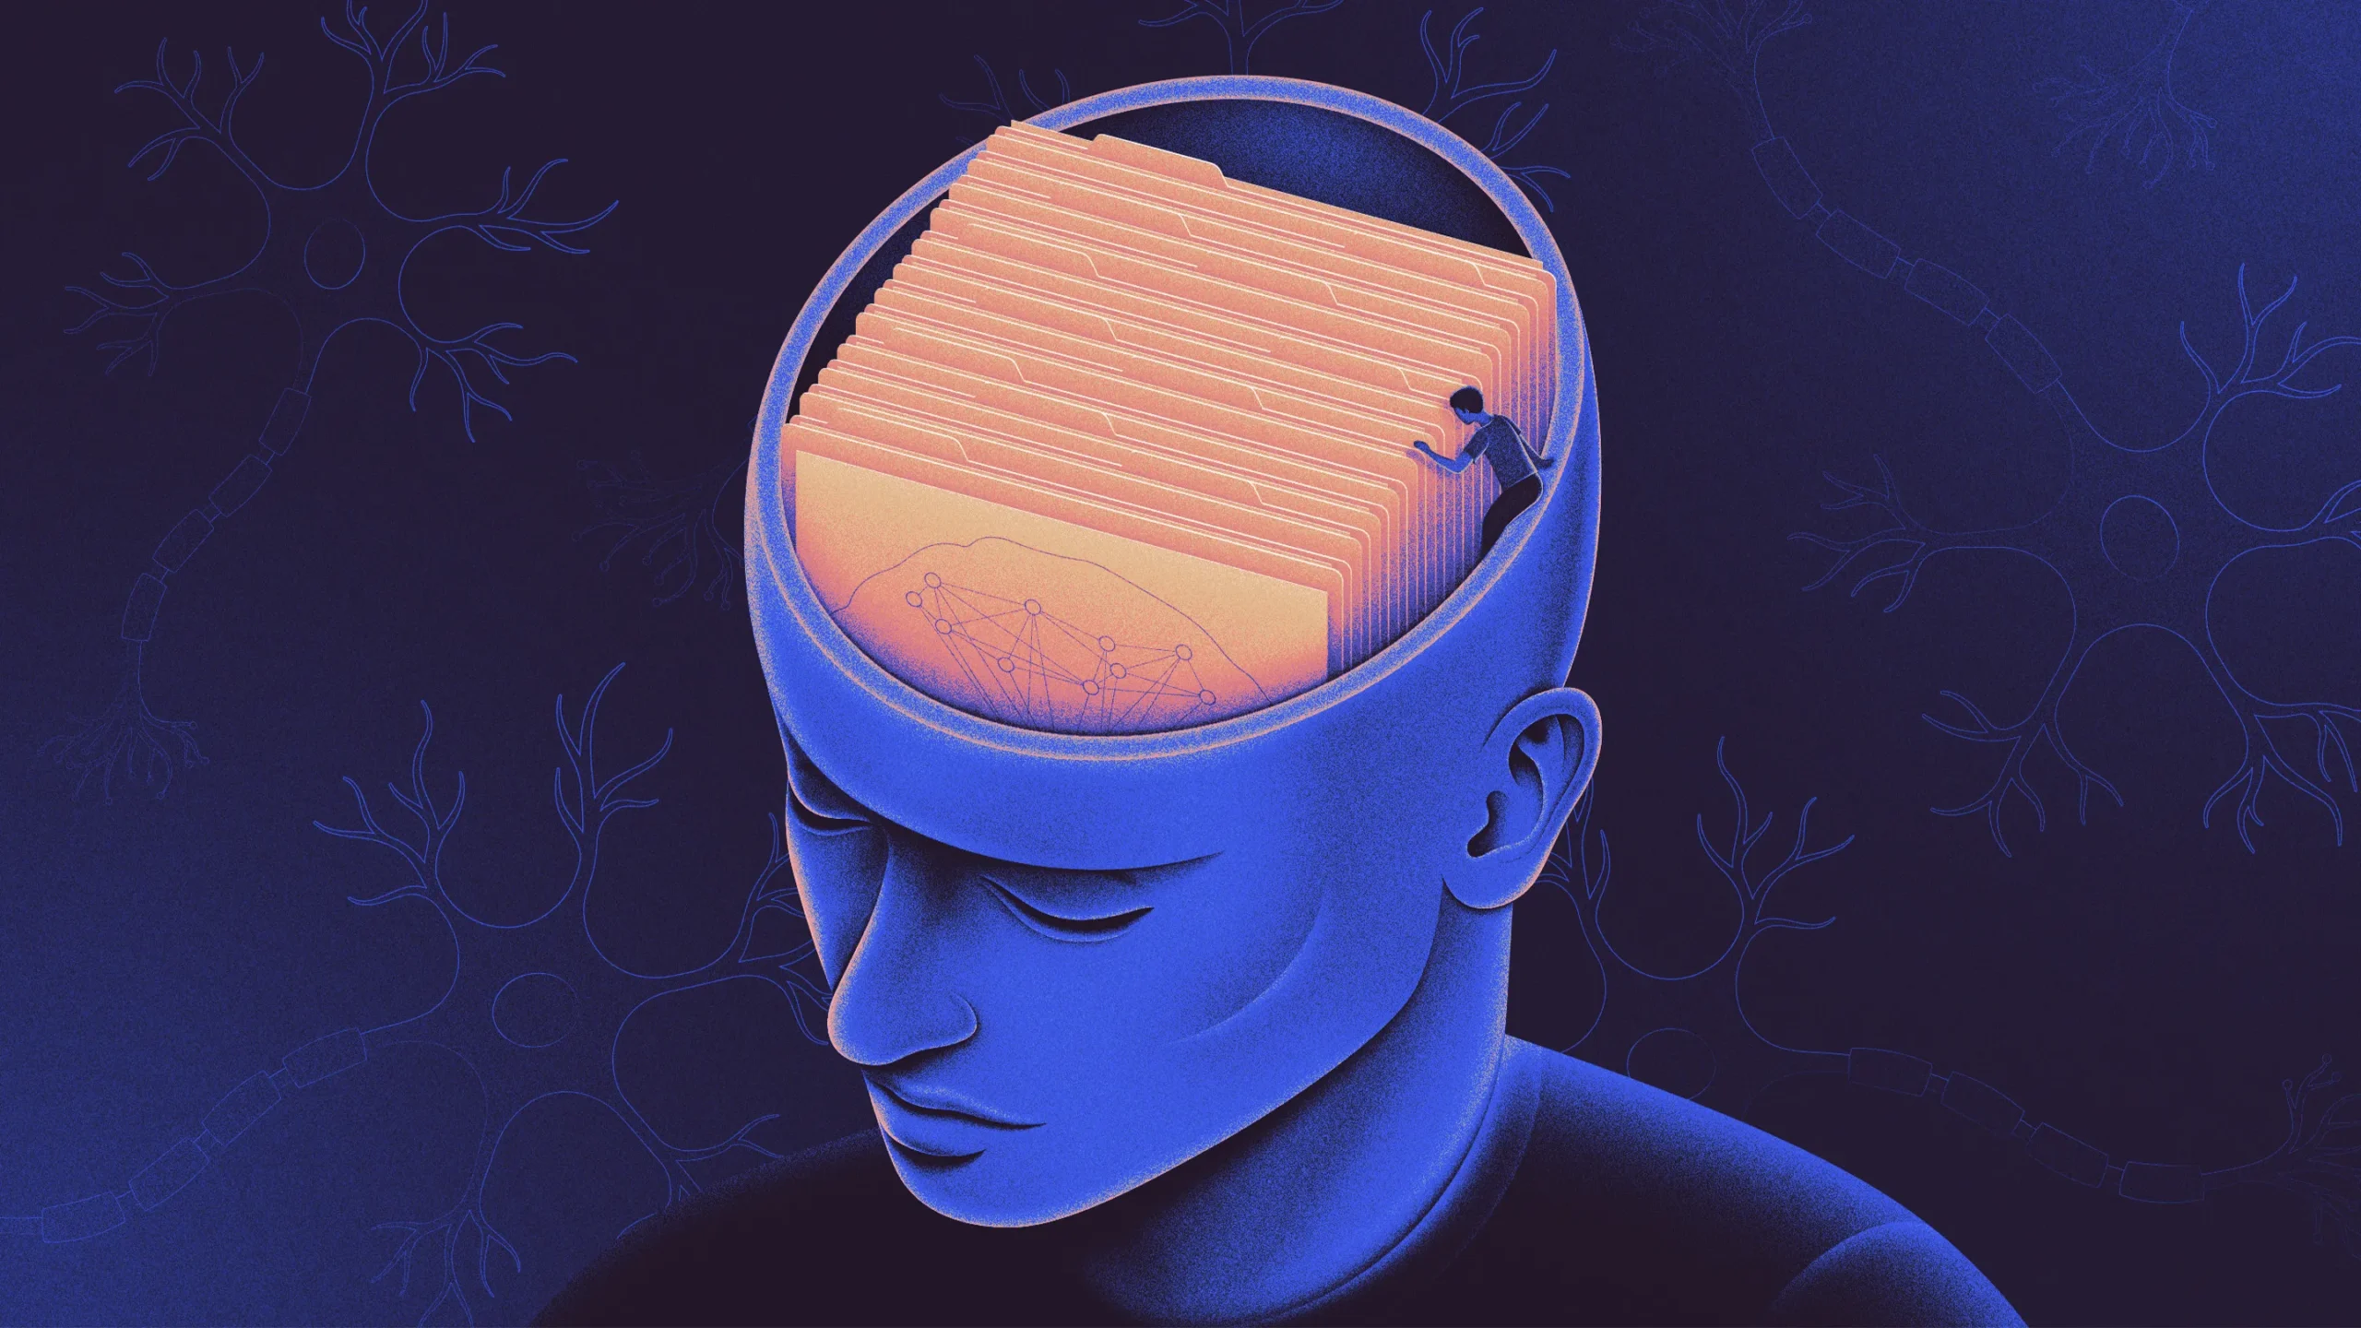
Step 3: Retrieving Memories

Slide 13
Forms of Retrieval
Recall
Recognition
Relearning

Slide 14
Parts of the Brain Involved in Memory

Slide 15
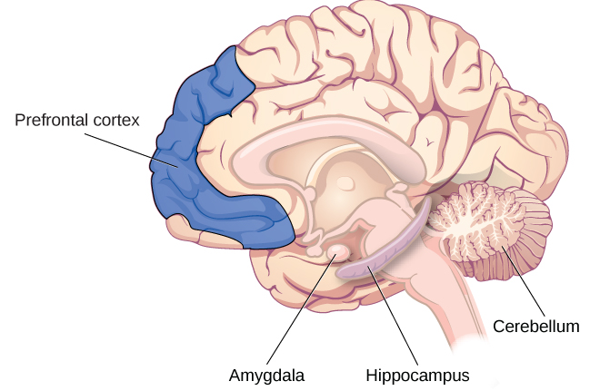
Parts of the Brain

Slide 16
The Brain in Action
Equipotentiality hypothesis: if part of one area of the brain involved in memory is damaged, another part of the same area can take over that memory function
Arousal theory: strong emotions trigger the formation of strong memories, and weaker emotional experiences form weaker memories
Indicates that neurotransmitters & hormones play a role in memory

Slide 17
Problems with Memory

Slide 18
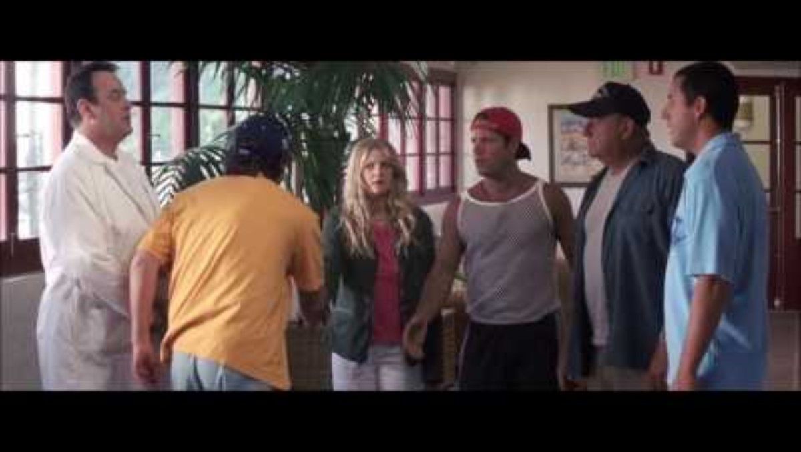
Anterograde Amnesia

Slide 19

Retrograde Amnesia

Slide 20
Forgetting

Slide 21
Schacter’s Seven Sins of Memory
Sin | Type | Description | Example
Transience | Forgetting | Accessibility of memory decreases over time | Forget events that occurred long ago
Absentmindedness | Forgetting | Forgetting caused by lapses in attention | Forget where your phone is
Blocking | Forgetting | Accessibility of information is temporarily blocked | Tip of the tongue
Misattribution | Distortion | Source of memory is confused | Recalling a dream memory as a waking memory
Suggestibility | Distortion | False memories | Result from leading questions
Bias | Distortion | Memories distorted by current belief system | Align memories to current beliefs
Persistence | Intrusion | Inability to forget undesirable memories | Traumatic events

Slide 22
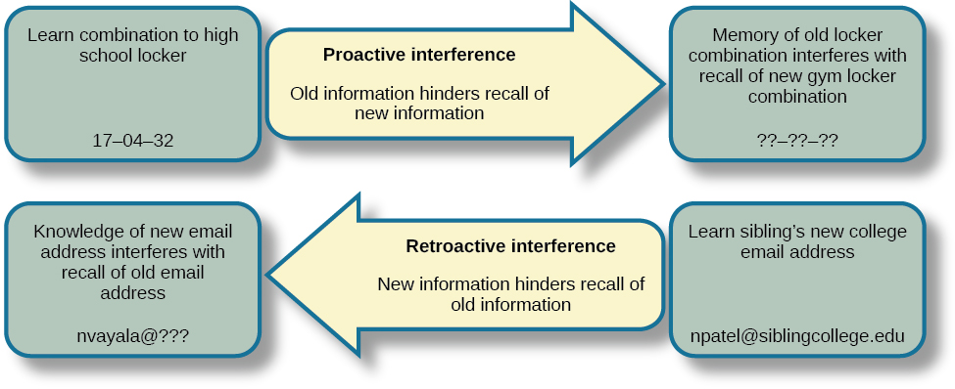
Interference

Slide 23
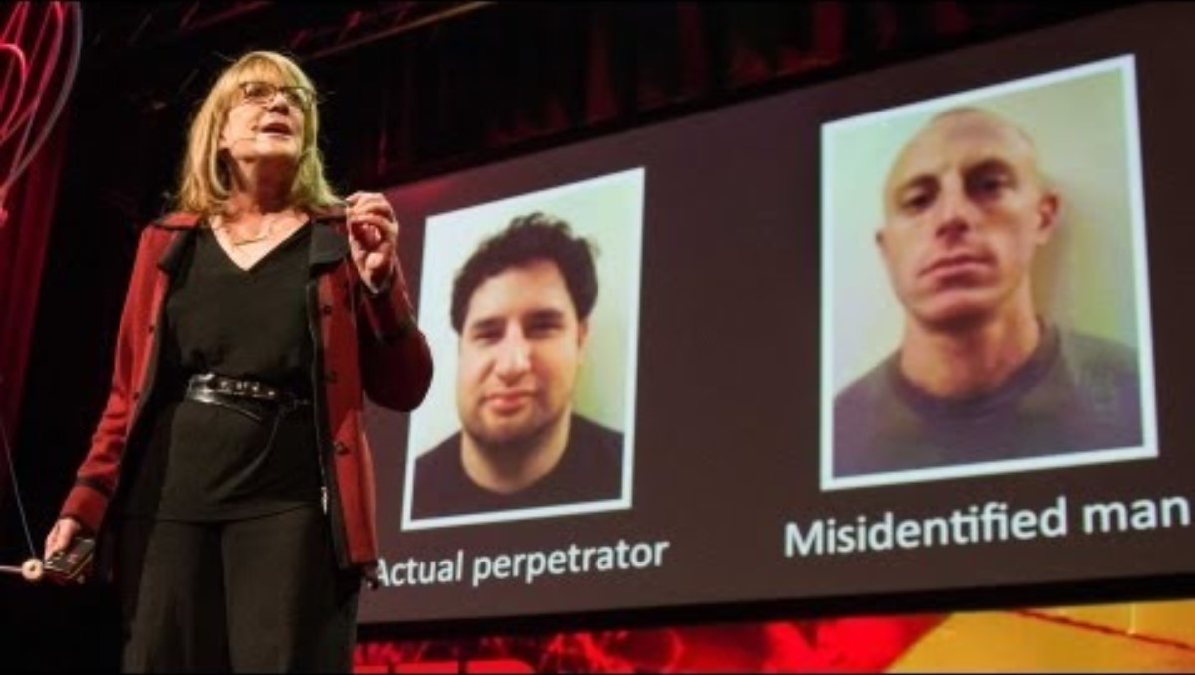
Misinformation Effect Paradigm
https://www.youtube.com/watch?v=PB2OegI6wvI

Slide 24
Ways to Enhance Memory

Slide 25
Memory Techniques
Elaborative rehearsal- a technique in which you think about the meaning of new information and its relation to knowledge already stored in your memory
Chunking- organize information into manageable bits or chunks
Which is easier to remember: “defhiindprs” or “friendship”?
Mnemonic devices- memory aids that help us organize information for encoding
Loci Method- a memory strategy based on associating a list of information with a mental route through a familiar place
Acronyms- abbreviations of initial words
ABC’s of learning (Antecedent- Behavior- Consequence)
Chain mnemonics- creating a story (or chain) to help you remember information
The more bizarre, the more likely to be remembered

Slide 26
How to Help Your Memory
Distributed practice
Study efficiently (50 minutes of focus, 10 minutes of rest, and repeat)
Use mnemonic devices
Apply the self-reference effect
Test yourself. Review your notes, then put them away and write down everything you can remember. Check what areas you didn’t include, and use those to guide what you focus on
Healthy food and lots of water
Plenty of sleep

Slide 27
Brain Games: Remember This
Watch Brain Games: Remember This
https://www.dailymotion.com/video/x1zwxcl
Email Dr. S the following information:
Paragraph 1: Summary of 1 portion/ scene of the show (with video times)
Paragraph 2: How it connects to course material (with PowerPoint numbers or textbook section info)
Get TWO extra credit points

Slide 28
Next Time on PSY 203…
Before Next Class:
Study Chapters 1, 2, 3, and 8
Next Class:
Exam 1

